Slide 1

SkyPi
Jacob Bauer, Matt Blaul, Troy Butzin, Daniel Ciesielski, Daniel Wade, Alexander Woodle

Slide 2

Risks & Challenges
Obtaining and testing various sensors (temperature, pressure, humidity) with different Raspberry Pi operating systems
Keeping consistent communication while developing at different times
Selected languages and IDEs
SSH Security - SSH Key Authentication

Slide 3

User Stories Completed in This Sprint
Backend Team
As an admin, I shall be able to edit user’s roles.
As an admin, I shall be able to view and edit any record in the database.
As a basic user, I shall be able to register, verify and log into a SkyPi account.
As a basic user, I shall be able to go to a SkyPi web address and receive weather data.
As a basic user, I shall be able to go to a SkyPi web address and receive device data.
As a basic user, I shall be able to go to a SkyPi web address and register a weather device.
FrontEnd Team (Besides Prototyping)
As a user, I want a site for viewing weather data.
As an admin, I want a prototype site to test compatibility.

Slide 4
User Stories Completed in This Sprint
PI Team
As an administrator, I want to utilize the raspberry pi sensors so that I can ensure the weather data for a particular area is being gathered and pushed to a database.
As an administrator, I want to utilize Raspberry Pi devices so that I can test new sensors for systems locally, and push code to all systems.
As an administrator, I want to utilize Ansible so that I can configure new Raspberry Pi weather stations.
As an administrator, I want to utilize Ansible so that I can update all systems, or individual systems.
As an administrator, I want to utilize Ansible so that I can register devices with an API.

Slide 5

Core API (Backend)
Software
API backbone almost complete
User authentication ( register / login / verification ) complete
User authorization (protected routes) with JSONWebTokens
User roles established, very basic
Device creation / registration / logging set up
Weather logging from devices set up and tested
Infrastructure
AWS Cloud Dev server configured

Slide 6

Front End Progress
Website
Website design chosen
Landing page established
React JS integration started
Challenges
Not as familiar with JS
React JS is new territory

Slide 7

Raspberry Pi
Operating system: Changed from DietPi to Raspbian Stretch Lite (version 9)
Email notifications for Raspberry Pi sensor errors
Using Python to retrieve data from various sensors
Pushing sensor data to MongoDB via API
Sensors:
DS18b20 Waterproof temperature sensor
Raspberry Pi Sense Hat (humidity, temperature, pressure)
BMP180 Barometric pressure, temperature, and altitude sensor
DHT22/AM2302 Digital temperature and humidity sensor
Challenges
Weatherproofing the Raspberry Pi & various sensors
Availability and compatibility of the sensors
Sensor costs

Slide 8
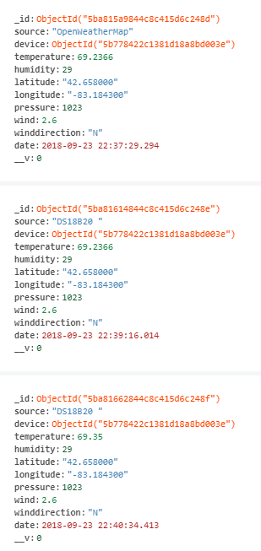
Raspberry Pi & MongoDB
Having the ability to collect weather data from the Raspberry Pi via sensors along with various weather APIs
OpenWeatherMap
DarkSky
Determining what data to collect
Determining what data to push to our database
Cron jobs: Scheduled tasks to push sensor information to MongoDB

Slide 9

Ansible and System Configuration
Tasks completed:
SSH server configuration
Security and Hardening
Iptables configuration
Account Creation
Locale and Time
API device and user registration
System upgrades
Installation of required packages
Installation of python modules
Challenges:
Numerous Brute Force Attempts
Locale and time differences on systems cause logging error
Python dependencies not always clear

Slide 10
Next Sprint
PI Team
VPN server for Pis
Add more hosts
Transition to new OS
Sensor Implementation on all hosts
Automated Reporting
Backend Team
Testing
Restrict weather data access
FrontEnd Team
Flesh out Website with other pages
Add Weather Chart to site

Slide 11
Questions?

